Slide 1
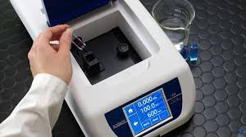
UV-VISIBLE SPECTROPHOTOMETER
Dr Minakshi Garg
Department of Chemistry
HBTU Kanpur

Slide 2
Spectroscopy is the measurement and interpretation of electromagnetic radiation absorbed or emitted when the molecules or atoms or ions of a sample moves from one energy state to another energy state.
UV spectroscopy is type of absorption spectroscopy in which light of ultra-violet region (200-400 nm) is absorbed by the molecule which results in the excitation of the electrons from the ground state to higher energy state.

Slide 3
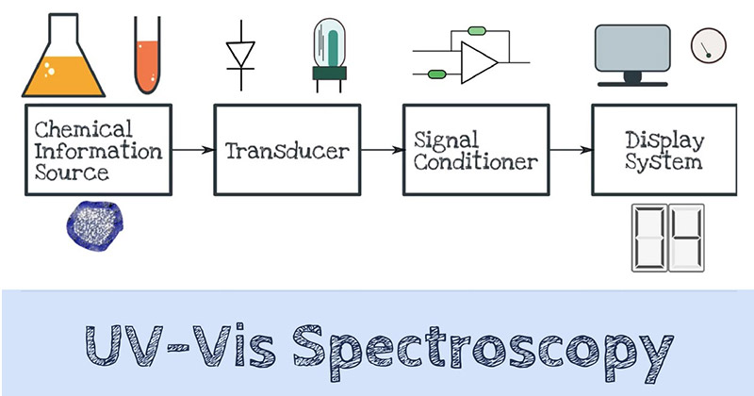

Slide 4
Principle of UV Spectroscopy
Basically, spectroscopy is related to the interaction of light with matter.
As light is absorbed by matter, the result is an increase in the energy content of the atoms or molecules.
When ultraviolet radiations are absorbed, this results in the excitation of the electrons from the ground state towards a higher energy state.
Molecules containing π-electrons or non-bonding electrons (n-electrons) can absorb energy in the form of ultraviolet light to excite these electrons to higher anti-bonding molecular orbitals.
The more easily excited the electrons, the longer the wavelength of light it can absorb. There are four possible types of transitions (π–π*, n–π*, σ–σ*, and n–σ*), and they can be ordered as follows: σ–σ* > n–σ* > π–π* > n–π*
The absorption of ultraviolet light by a chemical compound will produce a distinct spectrum which aids in the identification of the compound.

Slide 5
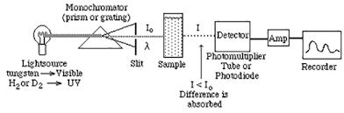
Instrumentation of UV-Vis Spectroscopy
Block Diagram of UV-Vis Spectrophotometer

Slide 6
Light Source
The most widely used and suitable light source as they cover the whole UV region are:
Tungsten filament lamps
Hydrogen-Deuterium lamps
Tungsten filament lamps are rich in red radiations; more specifically they emit the radiations of 375 nm
The intensity of Hydrogen-Deuterium lamps falls below 375 nm.

Slide 7
Monochromator
Monochromators generally is composed of prisms and slits.
Most of the spectrophotometers are double beam spectrophotometers.
The radiation emitted from the primary source is dispersed with the help of rotating prisms.
The various wavelengths of the light source which are separated by the prism are then selected by the slits such the rotation of the prism results in a series of continuously increasing wavelength to pass through the slits for recording purpose.
The beam selected by the slit is monochromatic and further divided into two beams with the help of another prism.

Slide 8
Sample and reference cells
One of the two divided beams is passed through the sample solution and second beam is passéd through the reference solution.
Both sample and reference solution are contained in the cells called as cuvette.
These cells are made of either silica or quartz. Glass can’t be used for the cells as it also absorbs light in the UV region.

Slide 9
Detector
Generally two photocells serve the purpose of detector in UV spectroscopy.
One of the photocell receives the beam from sample cell and second detector receives the beam from the reference.
The intensity of the radiation from the reference cell is stronger than the beam of sample cell. This results in the generation of pulsating or alternating currents in the photocells.

Slide 10
Amplifier
The alternating current generated in the photocells is transferred to the amplifier.
The amplifier is coupled to a small servometer.
Generally current generated in the photocells is of very low intensity, the main purpose of amplifier is to amplify the signals many times so we can get clear and recordable signals.

Slide 11
Recording devices
Most of the time amplifier is coupled to a pen recorder which is connected to the computer.
Computer stores all the data generated and produces the spectrum of the desired compound.

Slide 12
Applications of UV-VIS Spectroscopy
Detection of Impurities
It is one of the best methods for determination of impurities in organic molecules.
Additional peaks can be observed due to impurities in the sample and it can be compared with that of standard raw material.
By also measuring the absorbance at specific wavelength, the impurities can be detected.
Structure elucidation of organic compounds
It is useful in the structure elucidation of organic molecules, such as in detecting the presence or absence of unsaturation, the presence of hetero atoms.
UV absorption spectroscopy can be used for the quantitative determination of compounds that absorb UV radiation.

Slide 13
UV absorption spectroscopy can characterize those types of compounds which absorbs UV radiation thus used in qualitative determination of compounds. Identification is done by comparing the absorption spectrum with the spectra of known compounds.
This technique is used to detect the presence or absence of functional group in the compound. Absence of a band at particular wavelength regarded as an evidence for absence of particular group.
Kinetics of reaction can also be studied using UV spectroscopy. The UV radiation is passed through the reaction cell and the absorbance changes can be observed.
Many drugs are either in the form of raw material or in the form of formulation. They can be assayed by making a suitable solution of the drug in a solvent and measuring the absorbance at specific wavelength.
Molecular weights of compounds can be measured spectrophotometrically by preparing the suitable derivatives of these compounds.
UV spectrophotometer may be used as a detector for HPLC.

Slide 14
Thank You

